Slide 1
C+E Studio
Copilot AI Survey Feedback Wave #4 Microsoft Support Roles
October 2023
Prepared by:
Jeremy Heyer <jeremyheyer>
Justin Ericson <juericso>
MICROSOFT CONFIDENTIAL

Slide 2
October 2023
Table of Contents
Study Overview & Exec Summary
Survey Results
Qualitative Findings: Wins
Qualitative Findings: Copilot Feature Requests
Qualitative Findings: Opportunities
Recommendations & Next Steps
C+E Studio
2

Slide 3
Study Overview & Exec Summary

Slide 4


October 2023
Objectives
 | Gain a continued understanding of satisfaction, productivity, and usefulness of Copilot in customer service. Understand user sentiment of Copilot that can be applied across various Dynamics product spaces. Gather and analyze qualitative feedback producing Copilot wins and opportunities.
C+E Studio
4

Slide 5
October 2023
Methodology
Study Type: | Quantitative / Qualitative
Study Method: | Post-feature engagement survey / Open-ended responses
Participants: | 591 Microsoft Support Roles Last 60 days active Copilot use (telemetry)
Analysis: | Inspired by: AIX Trust Score and UX AI Product Fundamentals (see appendix slide 37 for complete survey) Thematic (free text responses)
Areas of Focus: | Satisfaction with Copilot features Perceived productivity of Copilot Perceived usefulness of Copilot Multiple (3) open-ended feedback questions
* Related Work
C+E Studio
Copilot Customer Feedback Wave 1.pptx
Copilot Survey Feedback Wave 2.pptx
DfM Copilot Discovery [April 2023] .pptx
Copilot Survey Feedback Wave 3.pptx
DfM Prompt and Training Discovery [Aug 2023].pptx
5

Slide 6
October 2023
Executive Summary
Poor satisfaction; a consistent downward trend across all metrics has emerged: 47% of support roles reported being satisfied with Copilot, which is a significant drop from 61% (wave 3) and 81% (wave 2). Despite the drop, users continued to identify Copilot as easy to use (72%) but no longer support its expansion (40%).
Support roles felt Copilot provided the most value when it was used to:
Generate case summaries
Produce small scripts, how-to guides, and quick steps for simple cases
Gain insight about unfamiliar cases
Co-author emails
Critical concerns regarding Copilot response and source accuracy continue to emerge: Copilot accuracy and relevancy continues its downward trend with users reporting less and less trust in Copilot output over time with 62% (wave 2), 48% (wave 3), and 39% (wave 4).
Usefulness gains not yet realized and dropping: Users continued to report that Copilot did not reduce their amount of work (37%), did not make their tasks easier (43%), and that they would not be disappointed if they could not use Copilot (45%). Factors contributing to this included:
Incorrect responses
Broken or missing sources
Minimal case content integration
Poor performance
Narrow data repository
C+E Studio
6

Slide 7
Survey Results

Slide 8

October 2023
DfM Copilot Survey Metrics
Overall Satisfaction
NSAT = 82 (+/- 4)
Target = 120
(Poor)
I think Copilot could have a lot of potential when chasing the right goals and when done right. I don't think we should give up on it. However, we are far from being there. Right now, in most use cases it is more cumbersome to use it, than to not. I could just go directly to the source knowing it is right, then read something where I am trying to spot what may be wrong. – Support Engineer
AI Trust- Productivity | % Top 2
Copilot helps me do my job more efficiently and effectively | 42%
The results provided by Copilot are accurate and relevant | 39%
Using Copilot in my work is an improvement to how things are done today | 48%
Copilot functionality should be expanded to all Roles | 40%
AI Trust - Usefulness
Copilot makes my work tasks easier | 43%
Copilot reduces the amount of work I have to do | 37%
I would be disappointed if I could not use Copilot for my work tasks | 45%
Copilot is easy to use | 72%
C+E Studio
Rating Scale:
>= 80% rating
70% - 79% rating
<70 % rating
10.2022 DTP AIX Trust Score Study Guide v3 .pptx
8
N=598

Slide 9
October 2023
DfM Copilot Survey Metrics
Comparative Metrics Wave 2 - 4
Wave 2
Wave 3
Wave 4
Satisfaction |  | NSAT
Overall, how satisfied are you with Copilot | 114 | 105 | 82
AI Trust- Productivity | % Top 2 | % Top 2 | % Top 2
Copilot helps me do my job more efficiently and effectively | 76% | 59% | 42%
The results provided by Copilot are accurate and relevant | 62% | 48% | 39%
Using Copilot in my work is an improvement to how things are done today | 86% | 58% | 48%
Copilot functionality should be expanded to all Support Engineers | 86% | 73% | 40%
AI Trust- Usefulness
Copilot makes my work tasks easier | 76% | 55% | 43%
Copilot reduces the amount of work I have to do | 48% | 43% | 37%
I would be disappointed if I could not use Copilot for my work tasks | 57% | 47% | 45%
Copilot is easy to use | 86% | 75% | 72%
The concept of Copilot is awesome! The problem is that the results are so inconsistent that I have to lab out every suggestion. Many times, the suggestions don't work or are missing key steps which equates to wasted time and delays in responding to customers. When the accuracy and consistency is improved it will really become useful. Until then, it is sort of a ball and chain that I'm dragging along with me. – Support Engineer
C+E Studio
Rating Scale:
>= 80% rating
70% - 79% rating
<70 % rating
9
10.2022 DTP AIX Trust Score Study Guide v3 .pptx
N=21
N=686
N=598

Slide 10
October 2023
About Net User Satisfaction (NSAT)
What is NSAT:
NSAT Calculation Formula:
NSAT is a number between 0 and 200 that represents how many very satisfied users you have compared against how many dissatisfied users you have.
NSAT = (VSat% - (SDSat%+VDSat%) ) + 100
NSAT Examples:
Interpreting NSAT Scores:
Very Good
Good
Neutral
Poor
Very Poor
>= 130
= 110 - 129
= 90 - 109
= 70 - 89
<= 69
C+E Studio
Very
dissatisfied
Somewhat
dissatisfied
Neither satisfied nor dissatisfied
Somewhat
satisfied
Very
satisfied

Slide 11
October 2023
NSAT (82) for Copilot was Poor, which was significantly lower than the previous wave, due to a decrease in the percentage of “Very Satisfied” responses (- 16%).
A Mann-Whitney U test was performed to evaluate whether there was a difference in Satisfaction for Copilot between survey waves. Results revealed significantly lower satisfaction between waves 3 and 4. U = 190941, p < .001
Converting Satisfaction to a 5-point scale provided the following results, which did not reveal any further insight
Average = 3.19
90% CI = 0.07
Overall, how satisfied are you with Copilot?
NSAT = 82 (+/- 4)
Target = 120
C+E Studio
Interpreting NSAT Scores
Very Good
Good
Neutral
Poor
Very Poor
>= 130
= 110 - 129
= 90 - 109
= 70 - 89
<= 69
Very
dissatisfied
Somewhat
dissatisfied
Neither satisfied nor dissatisfied
Somewhat
satisfied
Very
satisfied
MoE (+/-) represents 90% Confidence Intervals
Wave 4, n = 693;
Wave 3, n = 686;
Wave 2, n = 21
Copilot Survey Feedback Wave 2.pptx

Slide 12
October 2023
AI Composite Score: Results from Ongoing Work
AI UX Metrics Framework.pptx
Participants consistently indicate that Copilot is easy to use, but there is a continuing downward trend across the target metrics showing that DfM Copilot is not yet supporting intended efficiency gains.
59/100 COMPOSITE SCORE
Target = 75
USEFUL
USABLE
VALID
I would be disappointed if I could not use Copilot for work tasks
VALUE
Using the Copilot saves me time while I'm trying to accomplish my goals
The results provided by Copilot are accurate and relevant
C+E Studio
Copilot is easy to use
Error bars represent 90% Confidence Intervals
Wave 4, n = 598;
Wave 3, n = 686;
Wave 2, n = 21
Notes:
Justin

Slide 13

October 2023
AI Composite Score: Results from Ongoing Work
AI UX Metrics Framework.pptx
Participants consistently indicate that Copilot is easy to use, but there is a continuing downward trend across the target metrics showing that DfM Copilot is not yet supporting intended efficiency gains.
“So far, I don't see any compelling use-cases for me. It takes longer to correct any text or response it spits out and verify the information than it takes to do things myself.”
AI Composite Score:
59/100 COMPOSITE SCORE
Target = 75
I would be disappointed if I could not use Copilot for work tasks
Using the Copilot saves me time while I'm trying to accomplish my goals
Agreement scales scores converted to 0–100-point scale
Strongly agree = 100
Somewhat agree = 75
Neither agree nor disagree = 50
Somewhat disagree = 25
Strongly disagree = 0
The results provided by Copilot are accurate and relevant
C+E Studio
Copilot is easy to use
Error bars represent 90% Confidence Intervals
Wave 4, n = 598;
Wave 3, n = 686;
Wave 2, n = 21
Notes:
Justin

Slide 14
October 2023
AI Composite Score: Results from Ongoing Work
AI UX Metrics Framework.pptx
Recent research on the MSX Copilot are demonstrating similar results, highlighting that Copilots are Easy to Use but do not provide trustworthy responses to create value.
59/100 COMPOSITE SCORE
Target = 75
USEFUL
USABLE
VALID
I would be disappointed if I could not use Copilot for work tasks
VALUE
Using the Copilot saves me time while I'm trying to accomplish my goals
The results provided by Copilot are accurate and relevant
C+E Studio
Copilot is easy to use
Error bars represent 90% Confidence Intervals
n = 50;
Notes:
Justin

Slide 15

October 2023
Copilot was not perceived to improve productivity with inaccurate data requiring users to double-check information, thus the idea of expanding further was no longer ideal.
“The data and information accuracy is still not enough to trust Copilot results on any grounds and often we need to verify the received information to ensure it’s accurate, and that costs time.”
Trust in AI – Productivity
Average = 54 (+/- 2)
Target = 75
Agreement scales scores converted to 0–100-point scale
Strongly agree = 100
Somewhat agree = 75
Neither agree nor disagree = 50
Somewhat disagree = 25
Strongly disagree = 0
C+E Studio
Error bars represent 90% Confidence Intervals
Wave 4, n = 598;
Wave 3, n = 686;
Wave 2, n = 21

Slide 16

October 2023
Participants indicated that Copilot was easy to use, but there is still the perception that using Copilot is not actually useful, thus providing very low value, in its current state.
Trust in AI – Usefulness & Usability
“The output from Copilot is not useful for support of the product I work on since the complexity is usually very high.”
Average = 59 (+/- 2)
Target = 75
Agreement scales scores converted to 0–100-point scale
Strongly agree = 100
Somewhat agree = 75
Neither agree nor disagree = 50
Somewhat disagree = 25
Strongly disagree = 0
C+E Studio
Error bars represent 90% Confidence Intervals
Wave 4, n = 598;
Wave 3, n = 686;
Wave 2, n = 21
A sequence of Mann-Whitney U tests revealed no significant differences (p<0.1) from Wave 2 to Wave 3 results.

Slide 17
Qualitative Findings:
Copilot Wins

Slide 18


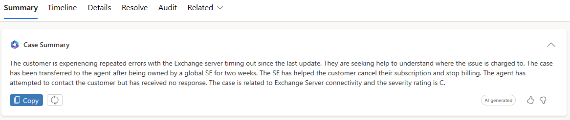
October 2023
Case Summary was considered valuable and the best Copilot feature
Users stated that the Case Summary feature was useful and produced “good” summaries of case content.
“The case summary functionality is awesome; it gets it right 95% of the time.”
“It creates a summary of the case that is one of its best features.”
“Super duper clear and concise [case] summary!”
Most users indicated that Case Summary provides its most value when catching up on long and messy cases.
“I love how it drafts the case summary and saves me time to read through all the notes.”
Users expressed that the ability of Copilot to produce quick and “mostly” accurate summaries has resulted in it being a go-to feature.
“Case Summary is the only Copilot feature I use.”
C+E Studio
18

Slide 19
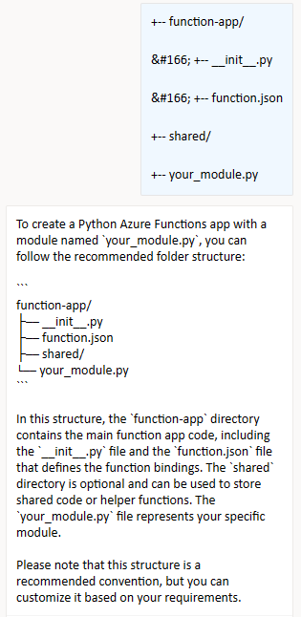
October 2023
Users continued to leverage Copilot for quick actions such as small scripts, quick steps, and how-to guides
Users indicated that Copilot was often fast at producing content, suggestions and documentation.
“It is easy to use and if asked the right question, it provides a quick answer along with documentation.”
“It is easily accessible and most of the time works fast.”
Despite issues with accuracy, most users continued to use Copilot for quick actions/content such as commands, scripts, and how-to guides.
“It’s really helpful for questions around small scripts which I can send to customers as part of troubleshooting.”
“It’s a quick search for articles – sometimes if they’re right.”
Past research has shown that users engage with Copilot for simple cases and to kickstart case investigations suggesting that users find value in simple Copilot tasks.
“It's a faster way to get immediate information while dealing with Support Requests or at least it gives hints to start the [case] investigation.”
C+E Studio
19

Slide 20
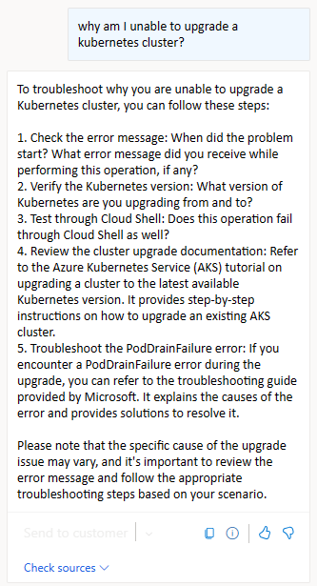
October 2023
Copilot aggregates and provides content in a way that boosts thinking and improves case support
Users have continuously expressed how Copilot facilitates self-learning opportunities and can boost thinking by offering innovative case content/suggestions.
“Copilot can introduce new ideas to my arsenal of skills.”
“When I’m lost, Copilot helps with troubleshooting.”
“It [Copilot] can open new branches of thinking.”
Some users reported that Copilot decreases the time spent searching for documentation (when present) which they attributed to improved customer support.
“It [Copilot] aggregates and collates information so that I no longer spend time searching for reference documents.”
“The prompt responses save me time to search in the knowledge bases.”
“If it finds information on a topic, it does a great job of providing you with what is needed as well as including the links to the data that it used.”
C+E Studio
20

Slide 21
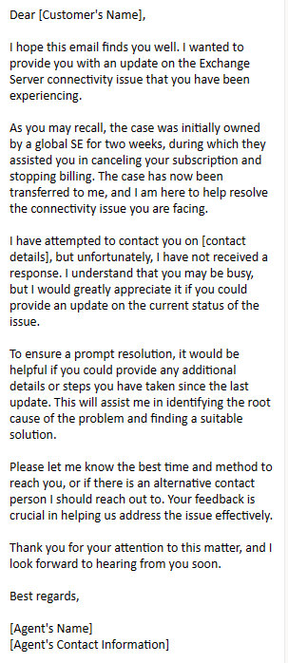

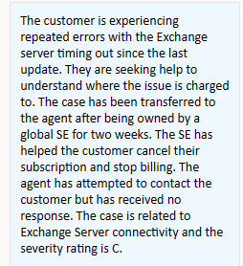
October 2023
Leveraging Copilot to co-author emails saves time and minimizes user input
Some users reported that engaging with Copilot to create and draft email content decreased their overall time on cases.
“Email creation is time-saving when working cases.”
“Its quite easy to use and helps a lot for formulated communication with the least number of inputs.”
Despite a need to edit Copilot generated content, users expressed support for the email feature.
“It is a great path to optimize our workflow and saves time for more important tasks.”
“Email suggestions are a very strong feature that my team refers a lot.”
Overall, Copilot’s ability to create/draft email content is strongly supported by users.
“All in all, Copilot makes writing emails faster.”
C+E Studio
21

Slide 22
Qualitative Findings:
Copilot Feature Requests

Slide 23
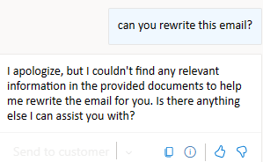
October 2023
Extended AI features such as rewriting emails, summarizing notes, and autocomplete was requested
As users continue to lean on Copilot for various case actions and tasks, their expectations of its capabilities grow.
Among the feature improvements suggested, rewriting emails and summarizing notes were highly ranked and considered valuable to users work.
“The ability to simply rewrite emails or sentences would be critical. I've tried to paste an example email [into Copilot] and the feedback was that Copilot didn't find any internal documentation to rewrite it.“
“The natural next step would be to allow Copilot to summarize case notes, so we gain efficiency on handovers.”
Autocomplete, a design feature well supported by users was suggested as it would streamline agent to AI interaction.
“If it [autocomplete] feature could be added to Copilot that would be great… It could populate during email or whenever we start typing.”
C+E Studio
23

Slide 24
Qualitative Findings:
Copilot Opportunities

Slide 25
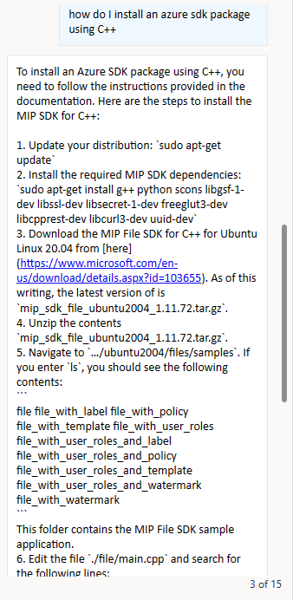
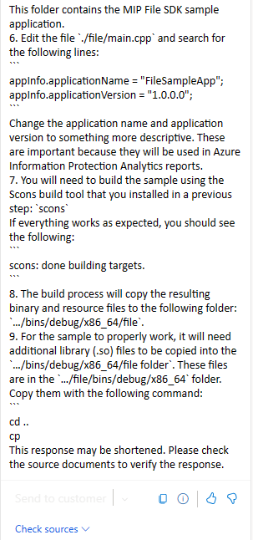
October 2023
Lack of response accuracy continues to plague Copilot output and responses
Copilot output is not accurate or reliable, which contributes to low adoption and disuse.
“Hallucinations are grammatically correct and contextual making it difficult to determine what is factually accurate.”
“I can't trust the info provided by Copilot. Plus, Copilot does not give us the source where the information came from.”
“Copilot had horrible accuracy in its results the few times I used it. It is to the point that I don't trust the information being presented and would rather not waste my time chasing answers that are incorrect.“
“Gives the incorrect answers a lot of the time. It sifts through internal documentation, but it doesn't seem like it fully understands it.“
“ALL answers need to be double-checked and verified, I currently see no real benefit and it does not seem to increase efficiency.”
“I feel that copilot is honestly to be taken with a very large grain of salt. The resources are shallow and the mistakes \ misinformation large.”
C+E Studio
25

Slide 26
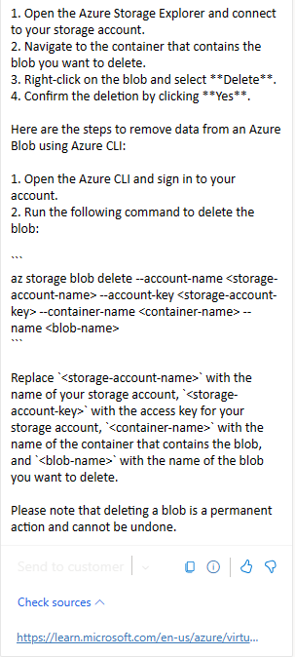
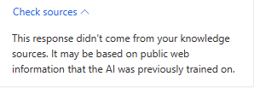
October 2023
Broken, inaccurate, or nonexistent case sources continue to frustrate users
Users need to easily verify the content that Copilot provides through accurate, present, and sharable sources.
“Sometimes it does not provide the links from where it got the information.”
“I rarely see sources for the information being provided which makes it even more difficult to validate information.”
“Copilot often cannot provide sources for the answers provided. Which makes the results kind of useless because I cannot verify the answers.”
Buggy and inconsistent source links further hinder trust resulting in source “dead ends”.
“Some answers state to check the reference article, but sometimes one never populates. After I ask where's the document, I get a reply stating there are no reference articles.”
“Often Copilot will show links that just don’t work.”
“Copilot is still not showing the source page where it is getting the case details it is providing.”
“Some answers did not contain the source which takes time to verify the correction.”
C+E Studio
26

Slide 27
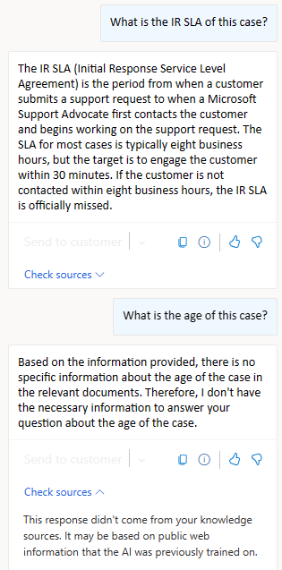
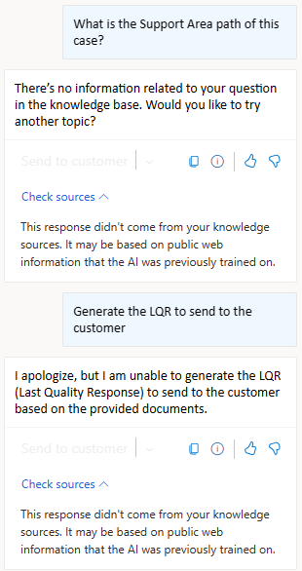
October 2023
Copilot needs to be trained on and integrated with more internal case content and resources
As seen in various Copilot studies, users continued to express a need for Copilot to be holistically integrated into DfM granting access to contextual case content and MS internal documentation/ resources.
“I would like to see it have all our CMS, CARE and process information.”
“Needs to be able to have more context of the current case opened. Technical information is not good enough.”
“Any plan for the Copilot to be aware of the open case? Otherwise, what value does it add?”
“It does not access TSG's articles written by colleagues supporting the same products I do.”
In many instances, users expressed belief that Copilot case integration would improve overall quality of responses.
“Copilot should be able to search through all data on the topic and question(s). It [Copilot] should provide a well-rounded and thorough explanation.”
C+E Studio
27

Slide 28


FINDING FROM MSX MVP USER EVALUATION
Sellers will have many Copilots to work with across our ecosystem. They will expect MSX Copilot to be a wealth of customer information we have in our databases.
Dynamics - MSX
Teams
Bing Chat
PowerPoint
Word
Excel
Outlook
Participants came to the MSX Copilot expecting it to connect to all of our source systems for customer info, internal sales processes, and commercial constructs.
‘‘I am trying to learn about my new accounts – Who are the main contacts? Who handles licensing and agreements? Who is the partner? How much revenue is being genrerated? What is the white space? What deals are in motion? What competitive products exist? Where have deals stalled? What’s the customer’s level of satisfaction? Show me agreement numbers and licensing.‘’
- Digital AE
‘’Some simple and basic information about each account would be great like: Who’s the ATS of this account? What is the LAP partner for this account? How many Office users do they have in this account? This is the type of questions that would really save time on my dalily basis – information that sometimes I have to consult multiple tools.’’
- DSE
‘’I don’t know if it even makes sense to have it go above and beyond helping me in the sales process until it can answer some of the basic information questions Who is the CSAM for this account? What licenses does the customer have access to?’’
- DSE
MSX Copilot - Initial MVP User Evaluation - Report.pptx

Slide 29
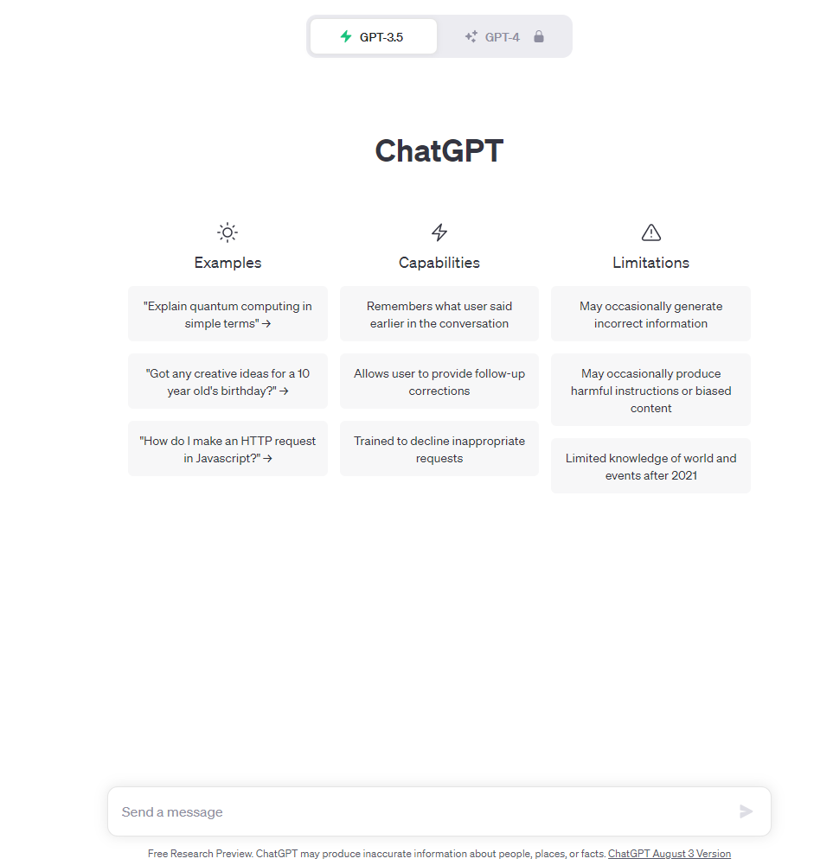
October 2023
Users expect Copilot to have ingested a broader array of knowledge resources
There is expectation that Copilot functions more like a traditional LLM, pulling data/resources from an expansive repository of knowledge.
“The capabilities we have with ChatGPT, such as text summarization, text generation, text rewriting, and text adjustments, are all lacking in Copilot.”
“Copilot is not able to provide relevant action plans for simple queries and when compared to ChatGPT, it feels like a downgrade.”
Additionally, recurrent issues with response accuracy has resulted in users questioning the quality of the data being fed to Copilot.
“Content fed to it [Copilot] is poor quality. Copilot can only be as good as the documentation used to feed it. We have very poorly maintained internal documentation on how to support different products.”
“I can't blame all the negative comments on the tool itself. But garbage in = garbage out no matter how you spin it. The lack of content fed to it is part of the problem which leads to a mismatch of responses that are partly right.”
C+E Studio
29

Slide 30
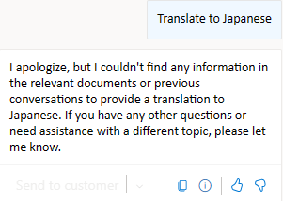
October 2023
Lack of translation and local language support resulted in accessibility blockers
Copilot’s inability to support multiple languages such as Japanese has resulted in poor work arounds and increased time on cases.
“Although the process of understanding the Japanese query content and returning the results is working fine, it would be better if the results were returned not in English, but in the language of the query content.”
“I cannot use Japanese at all.“
“I would like to see support for various languages, as that [content] may not be interpreted correctly in Japanese.”
Previous research indicated user satisfaction with general translation of cases. However, this feedback suggests that as Copilot expands, access to preferred and local languages need to be addressed.
“We need multi-language support.”
“Please let us use our local language.”
C+E Studio
30

Slide 31
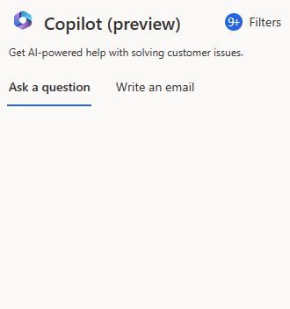

October 2023
Poor DfM performance resulted in noted stability issues with Copilot
Users reported stuck, staggering, or crashing Copilot experiences throughout various levels of engagement within the DfM tool.
“Performance is horrendous; it takes 10 seconds to load a case and much more to edit.”
“In a lot of cases, DfM Copilot just didn’t respond.”
“Copilot doesn't always work. At times, I ask something, and no feedback is generated.”
“Due to DFM instability, I haven't really gotten the opportunity to use it as much as I want as it crashes often.”
“Sometimes it [Copilot] gets stuck and unresponsive.”
While users' expressed frustration over performance issues there is uncertainty whether it is due to the feature (Copilot) or the tool (DfM).
“Not knowing if a performance issue, for example, is due to copilot, or all of DFM is a persistent struggle.”
C+E Studio
31

Slide 32
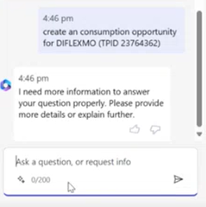
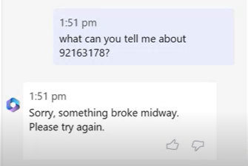
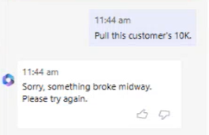
FINDING FROM MSX MVP USER EVALUATION
!
Error states put users in a dead end and lead to quick abandonment. They need to know what went wrong, and ways to remediate it.
Users in our study said they often ran into error messages while using Copilot. We observed this during interviews as well – many tasks users tried couldn’t be completed due to stability issues or unclear error states.
These error states lead to a dead end – users were lost with no way to proceed because there weren’t clear descriptions of what was wrong, or what they needed to do to avoid the errors in the future.
This led users to quickly abandon Copilot and go back to their original way of finding information. When consistently hitting errors, they felt they could achieve the same goals faster on their own.
‘’But what information does it require? What further details? That would be cool to know. I just wander what else copilot needs.’’
- Digital CSA
‘’This is normally what I have been getting. Something broke. That’s why I kind of stopped using it.’’
- Specialist
Opportunity
Reducing crashes and error states is of great importance – our participants were willing to quickly abandon it if they could not help with their intended tasks.
Explain error states to the user to the best of our ability so they always have a next step, or know what to change about their prompt for better success in the future.
‘’I wonder if it can’t even do that? I wish it would just tell me.’’
- CSA Manager
MSX Copilot - Initial MVP User Evaluation - Report.pptx

Slide 33
Recommendations & Next Steps

Slide 34
October 2023
Key Recommendations
Prioritize improving the accuracy and relevancy of Copilot responses.
User dissatisfaction stems from a lack of trust, until we address accuracy, we cannot build trust.
Explore novel ways to indicate trustworthiness on Copilot responses.
Review and ensure the three elements in the distrust hierarchy (Wave 3; slide 36) are addressed.
Focus on improving source content by ensuring it is accurate, active, and sharable.
Inconsistencies with provided source content is the second most constant feedback from users.
Continue to focus and refine Copilot in the areas where it excels: providing case summaries, answering simple prompts, and initiating case investigations.
Users continue to identify Copilot as valuable with simple tasks. Maximizing Copilots ability to perform these actions will only lead to further adoption and retention.
Prioritize implementing multiple language support to increase accessibility and usefulness.
Expanding supported languages will increase accessibility to numerous users.
C+E Studio
34

Slide 35
October 2023
Summary: What We Learned
Copilot is still not trustworthy: Users acknowledge that Copilot is easy to use, but without trust, it will continue to have minimal value in its current state.
All metrics have shown a steady decline over time: Wave 2 through 4 shows consistent decreases in user sentiment indicating that any existing “user confidence” in Copilot is receding.
Response accuracy continues to plague Copilot: Accurate and relevant output is critical for user acceptance, adoption, and retention.
Language support, case integration, and inconsistent sources surfaced as critical gaps to adoption: Without addressing these gaps, Copilot remains usable but not useful.
Simple tasks continue to emerge as primary use cases: Users continue to leverage Copilot to complete simple tasks such as email crafting, how-to guides, and answering simple prompts.
Case summary received strong positive feedback: This feature was considered highly valuable and useful by users.
C+E Studio
35

Slide 36
C+E Studio
Thank you!
MICROSOFT CONFIDENTIAL

Slide 37
Appendix

Slide 38
June 2023
Copilot Response Distrust Hierarchy
Response Distrust
Broken, inaccurate resources
Persistent response inaccuracies
False confidence
Without sources, responses cannot be verified or validated resulting in users questioning the data
Lures new and junior engineers into a false sense of accuracy by presenting content with high-confidence, despite being inaccurate
C+E Studio
Engineers question the accuracy when the same prompts produce different, inconsistent answers or the answers are incorrect (via validation)
38

Slide 39
October 2023
Copilot Survey
Questions inspired by the AIX Trust Score Survey and UX AI Product Fundamentals 10.2022 DTP AIX Trust Score Study Guide v3 .pptx
1. Overall, how satisfied or dissatisfied are you with Copilot in DfM?
…..
What, if anything, do you find frustrating or unappealing about Copilot in DfM? (optional)
What do you like best about Copilot in DfM? (optional)
…..
Copilot is easy to use.
The results provided by Copilot are accurate and relevant.
Using Copilot saves me time while I’m trying to accomplish my goals.
I would be disappointed if I could not use Copilot for my work tasks.
…..
Copilot helps me do my job more efficiently and effectively.
Using Copilot in my work is an improvement to how things are done today.
Copilot functionality is ready to be expanded to all roles.
Copilot makes my work tasks easier.
Copilot reduces the amount of work I have to do.
…..
Qual feedback on Copilot (free text box)
AI Composite Metrics
Previously Collected Metrics
C+E Studio

Slide 40


















October 2023
C+E Studio Research Team - March 2023
FTE
Vendor
`
Leadership
Ashley Graham Director of Research
SPS + Shared Exp
Finance
UX Health/Metrics
Jason Vasilas Principal Research Manager
Adam Lamb Senior UX Researcher
Daren Chaisy Vendor Researcher
Rebecca Peters UX Researcher II
Sarah Karmali UX Researcher II
Kimberley Harris Phillips Senior UX Researcher
Justin Ericson Senior UX Researcher
MDM
Pro Svcs
INDIA
Dane Andersen UX Researcher II
Neha Dhawan UX Researcher II
Lina Rothman Vendor Researcher
Vaishnavi Ramakrishnan UX Researcher II
Shweta Roy Chowdhury UX Researcher II
Skilling
Ana Pitchon Senior UX Researcher
Support (Reactive)
C+E Studio
Jeremy Heyer Senior UX Researcher
Emily Murphy UX Researcher I
40

